Slide 1
Data Structures QUEUE
Dr.T.VEERAMANI-CSE/SIST

Slide 2
UNIT-4 TOPIC
Basic Queue Operations
Representation of a Queue using array
Applications of Queues
Round robin Algorithm
Enqueue
Dequeue
Circular Queues
Priority Queues

Slide 3
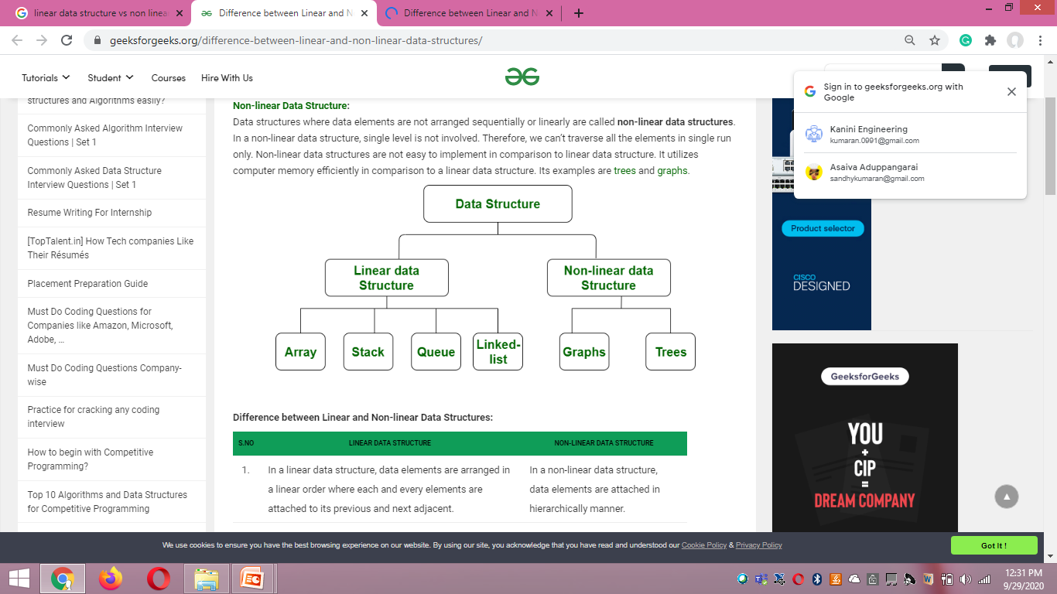
Data Structures

Slide 4
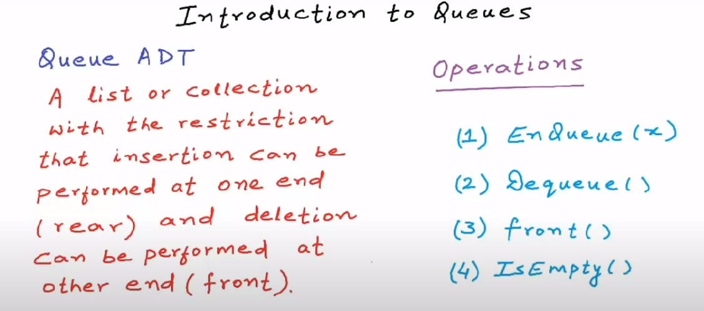

Slide 5
Types of queues
Linear queue
Circular queue
Double ended queue
Priority queue

Slide 6
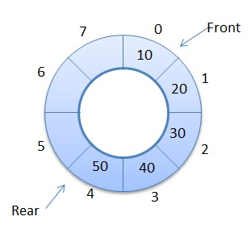
Circular queue
Here, front and rear are connected to make a circle. It stores elements in circular way and perform operations on FIFO basis. It contains a collection of data which allows insertion of data at the end of the queue and deletion of data at the beginning of the queue.

Slide 7
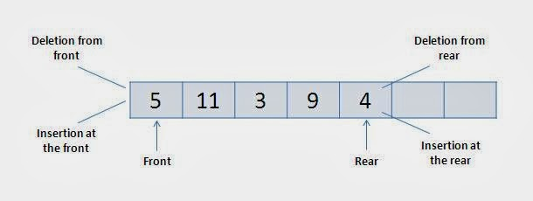
Double-ended queue/ Deque Here, insert and delete operation can be occur at both ends that is front and rear of the queu

Slide 8
Queue Basics
FIFO - First In First Out
FCFS - First Come First Serve
Operations
Insertion (or) Enqueue - At one End (Rear | Tail)
Deletion (or) Dequeue - At one End (Front | Head)
Front
Rear
5 | 4 | 6 | 3 | 1 | 2 | 5
Dequeue()
Enqueue()

Slide 9
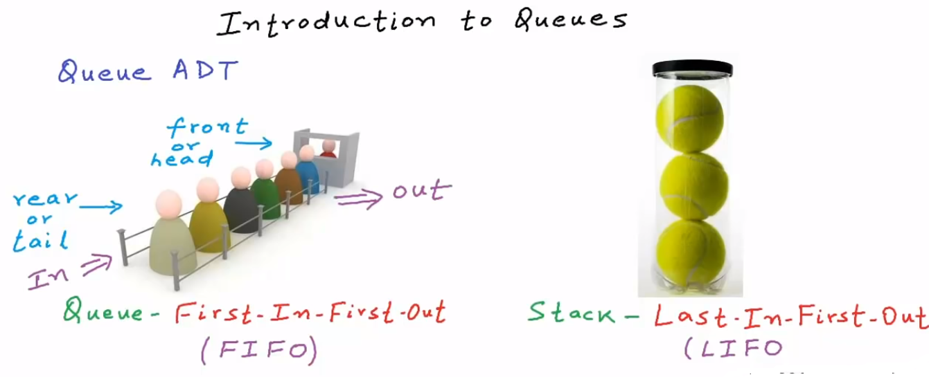

Slide 10
Queue Operations
Enqueue(x)
Dequeue()
Peek() or Front()
isEmpty()
isFull()

Slide 11
Queue Operations
-1
0 | 1 | 2 | 3 | 4 | 5 | 6
Rear
Front
Enqueue(2)
Front=rear=-1 → Queue is Empty
-1
0 | 1 | 2 | 3 | 4 | 5 | 6
2
Rear
Front

Slide 12
Queue Operations
Enqueue(10)
-1
0 | 1 | 2 | 3 | 4 | 5 | 6
2 | 10
Front
Rear
Enqueue(5)
-1
0 | 1 | 2 | 3 | 4 | 5 | 6
2 | 10 | 5
Front
Rear

Slide 13
Queue Operations
Dequeue()
-1
0 | 1 | 2 | 3 | 4 | 5 | 6
2 | 10 | 5
Enqueue(6)
Rear
Enqueue(8)
Front
Enqueue(10)
Enqueue(3)
Enqueue(22)
-1
0 | 1 | 2 | 3 | 4 | 5 | 6
2 | 10 | 5 | 6 | 8 | 10 | 3
Front
Rear
Enqueue(22) → Overflow Condition

Slide 14
Queue Operations
-1
0 | 1 | 2 | 3 | 4 | 5 | 6
2 | 10 | 5 | 6 | 8 | 10 | 3
Peek()
Front
Rear
Dequeue()
Dequeue()
Dequeue()
Dequeue()
Dequeue()
-1
0 | 1 | 2 | 3 | 4 | 5 | 6
2 | 10 | 5 | 6 | 8 | 10 | 3
Front=rear=-1 → Queue is Empty
Front
Rear
Front==rear → One Element in the queue
Dequeue() →
Front=rear=-1 → Queue is Empty
Front>rear
→ Queue is Empty

Slide 15
Queue Operations → Time Complexity
Enqueue(x)
Dequeue()
Peek() or Front()
isEmpty()
isFull()
O(1)

Slide 16
Queue Operations → Drawbacks
-1
0 | 1 | 2 | 3 | 4 | 5 | 6
2 | 10 | 5 | 6 | 8 | 10 | 3
Enqueue(6)
Front
Rear
Queue is Full

Slide 17
Queue Applications
Single Shared Resource
Printer
Processor
In real life scenario, Call Center phone systems uses Queues to hold people calling them in an order, until a service representative is free.
Handling of interrupts in real-time systems. The interrupts are handled in the same order as they arrive i.e. First come first served.
When you send messages on social media, they are sent to a queue to the server.
An important way of traversal in a graph: Breadth First Search uses queue to store the nodes that need to be processed.
Queues are used in handling asynchronous communication between two different applications or two different processes.

Slide 18
Queue Implementation
Queue Implementation using Array
Queue Implementation using Linked List
Queue Implementation using Stack

Slide 19
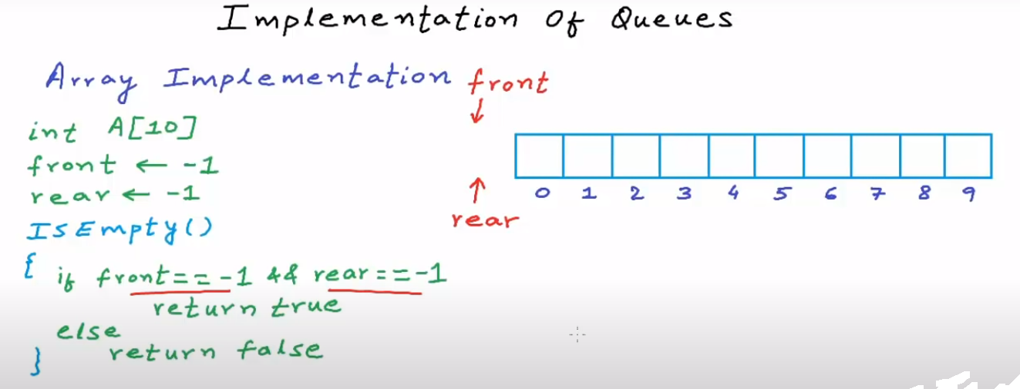

Slide 20
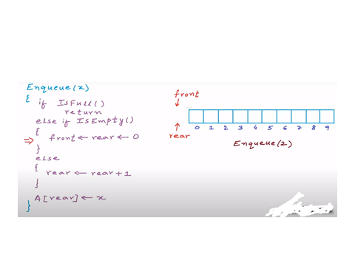

Slide 21
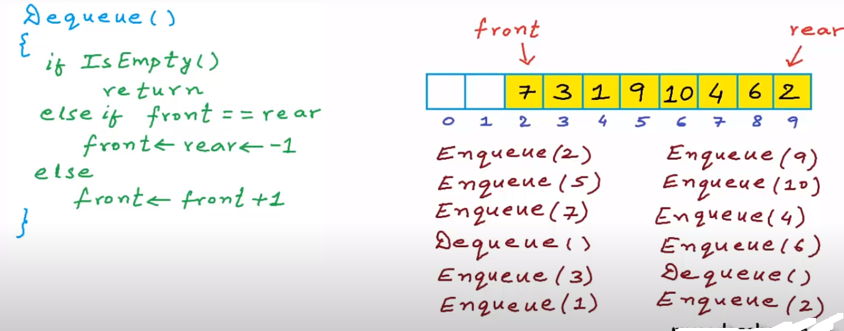

Slide 22
Queue Implementation using Array
void main ()
{
enqueue(2);
enqueue(5);
enqueue(6);
display();
peek();
dequeue();
peek();
display();
}

Slide 23
Queue Implementation using Array → Enqueue(x)
0 | 1 | 2 | 3 | 4
# define N 5
int queue[N];
int front=-1
int rear=-1
void enqueue(int x)
{
if (rear==N-1)
{
printf(“Queue is Full”);
}
else if(front==-1 && rear==-1)
{
front=rear=0;
queue[rear]=x;
}
else
{
rear++;
queue[rear]=x;
}
}
-1
Rear
Front
-1
0 | 1 | 2 | 3 | 4
2
Front
Rear
-1
0 | 1 | 2 | 3 | 4
2 | 5 | 6
Front
Rear

Slide 24
Queue Implementation using Array → Dequeue()
void dequeue()
{
if(front==-1&&rear==-1)
{
printf(“queue is empty”);
}
else if (front=rear)
{
front=rear=-1;
}
else
{
printf(“ The Dequeue element is %d”, queue[front]); front++;
}
}
-1
0 | 1 | 2 | 3 | 4
Rear
Front
-1
0 | 1 | 2 | 3 | 4
2 | 6 | 7 | 8 | 9
Front
Rear
-1
0 | 1 | 2 | 3 | 4
2 | 5 | 6
Front
Front++
Rear

Slide 25
Queue Implementation using Array → Display()
void display()
{
int i;
if(front==-1&&rear==-1)
{
printf(“queue is empty”);
}
else
{
for (i= front; i<rear+1;i++)
{
printf(“ The Elements is %d”, queue[i]);
}
}
}
-1
0 | 1 | 2 | 3 | 4
2 | 5 | 6
Front
Rear

Slide 26
Queue Implementation using Array → Peek()
void peek()
{
if(front==-1&&rear==-1)
{
printf(“queue is empty”);
}
else
{
printf(“ The front elements is %d”, queue[front]);
}
}
-1
0 | 1 | 2 | 3 | 4
2 | 5 | 6
Front
Rear

Slide 27
Queue Implementation using Linked List
500
Head
4 | 100
3 | 200
5 | 300
6 | 0
500
100
200
300
Front
Rear
300
500
4 | 100
3 | 200
5 | 300
6 | 0
500
100
200
300
Front → Dequeue
Rear→ Enqueue

Slide 28
Queue Implementation using LL → main()
void main()
{
enqueue(4);
enqueue(3);
enqueue(5);
display();
dequeue();
peek();
}

Slide 29
Queue Implementation using LL → Enqueue(x)
front
rear
struct node
{
int data;
struct node * next;
}
struct node * front=0;
struct node * rear=0;
void enqueue (int x)
{
struct node* newnode;
newnode=(struct node*)malloc(sizeof(struct node));
newnode→data=x;
newnode→next=0;
4 | 0
500
500
newnode

Slide 30
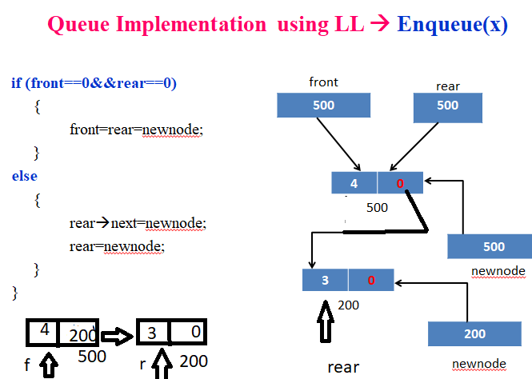

Slide 31
Queue Implementation using LL → Display()
void display()
{
struct node * temp;
if (front==0&&rear==0) Temp rear
{ F
printf(“queue is empty”);
}
else
{
temp=front;
while(temp!=0) 500 200
{
printf(“%d”, Temp→data);
temp=temp→next; temp
}
}
}
4
200
3
0

Slide 32
Queue Implementation using LL → Dequeue()
void dequeue()
{
struct node* temp;
temp=front;
if (front==0&&rear==0)
{
printf(“queue is empty”);
}
else
{
printf(“%d”, front→ data);
front=front→ next;
free(temp);
}

Slide 33
Queue Implementation using LL → Peek()
void peek()
{
if (front==0&&rear==0)
{
printf(“queue is empty”);
}
else
{
printf(“%d”, front→ data);
}
}

Slide 34
Implementation of Queue using Stack

Slide 35
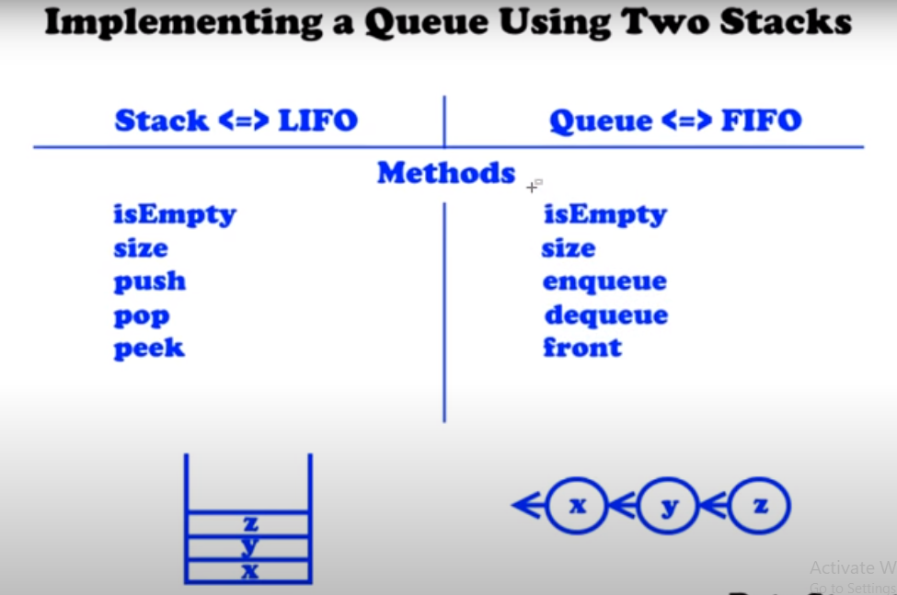

Slide 36
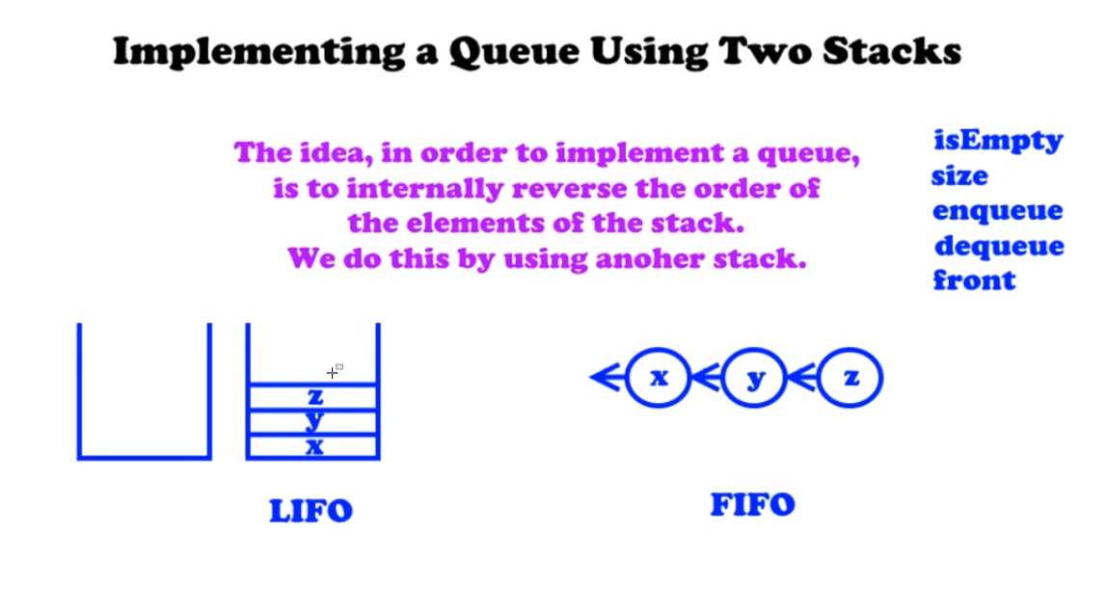

Slide 37
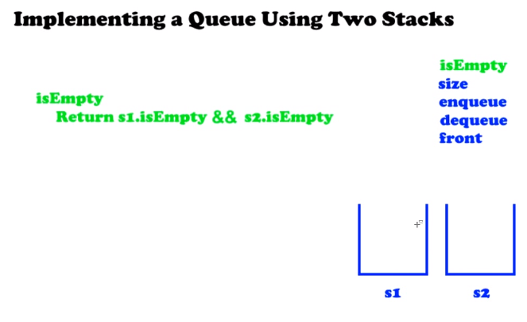

Slide 38
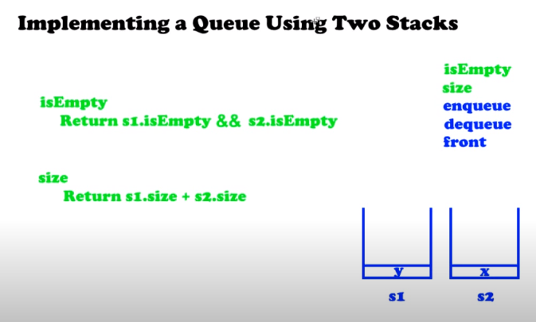

Slide 39
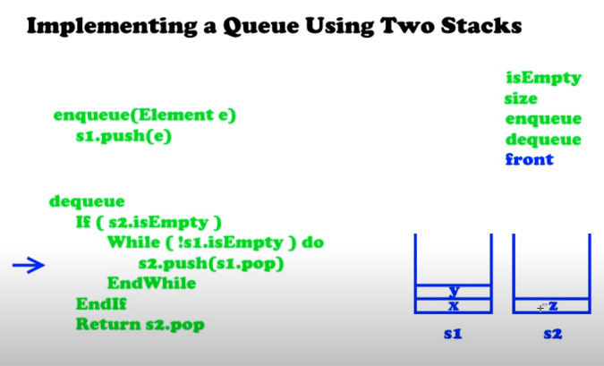

Slide 40
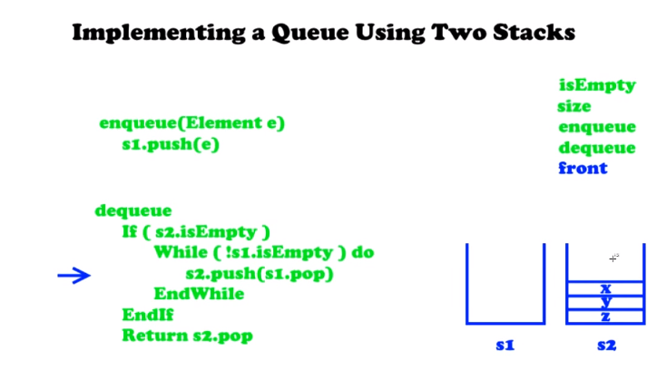

Slide 41
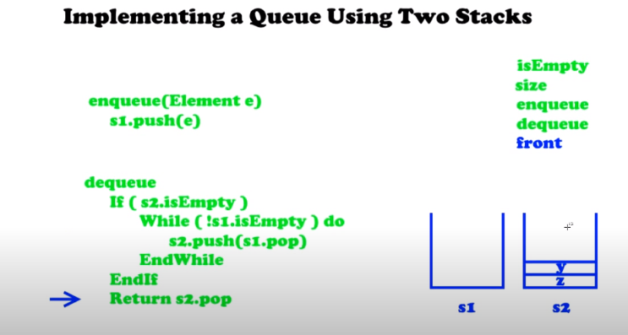

Slide 42
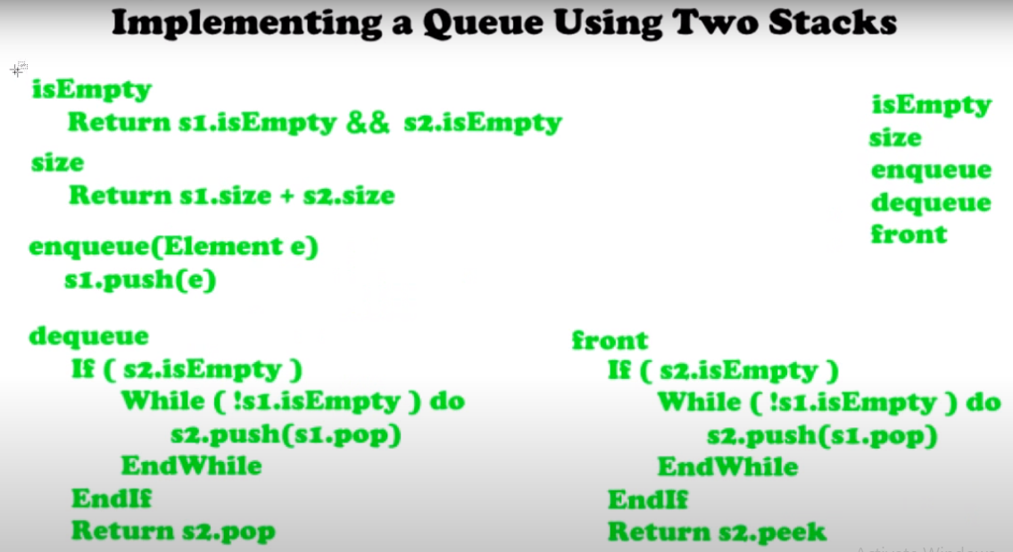

Slide 43
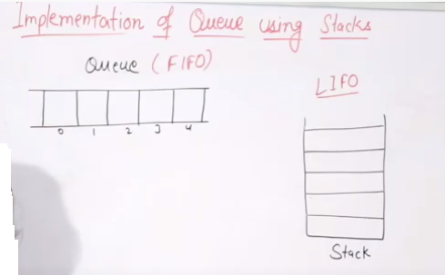

Slide 44
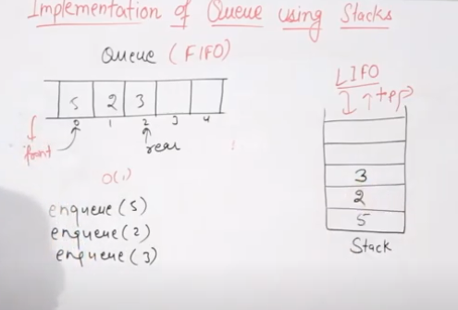

Slide 45
Implementing queue using stacks by making the enqueue operation costly is discussed below.
Initialize stack1 and stack2 making top1 = top2 = -1.
To perform an enqueue operation,
Push all the elements from stack1 to stack2.
Push the new element to stack2.
Pop all the elements from stack2 to stack1.
3. To perform dequeue operation,
Pop and return the element from stack1.

Slide 46
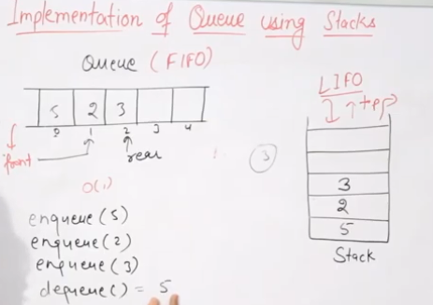

Slide 47
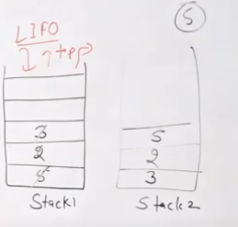

Slide 48
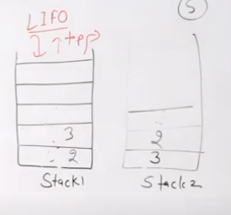

Slide 49
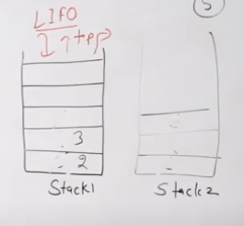

Slide 50
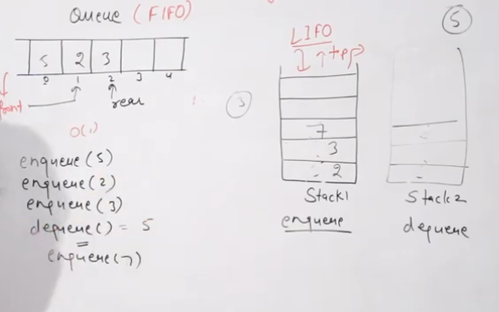

Slide 51
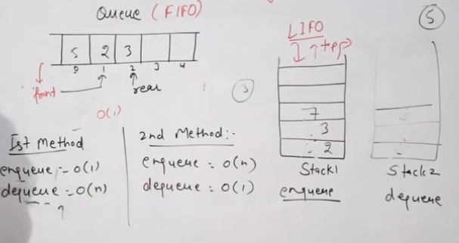

Slide 52
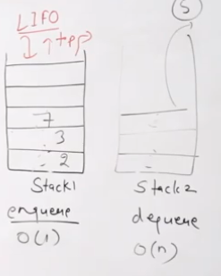

Slide 53
Implementing queue using stacks by making the enqueue operation costly is discussed below.
Initialize stack1 and stack2 making top1 = top2 = -1.
To perform an enqueue operation,
Push all the elements from stack1 to stack2.
Push the new element to stack2.
Pop all the elements from stack2 to stack1.
3. To perform dequeue operation,
Pop and return the element from stack1.

Slide 54
#include <stdio.h>
#include <stdlib.h>
/* Functions and variables used */
void push1(int);
void push2(int);
int pop1();
int pop2();
void enqueue();
void dequeue();
void display();
void create();
int stack1[100], stack2[100];
int top1 = -1, top2 = -1;
int count = 0;

Slide 55
/* Main Function */
int main()
{
int choice;
printf("\nQUEUE USING STACKS IMPLEMENTATION\n\n");
printf("\n1.ENQUEUE");
printf("\n2.DEQUEUE");
printf("\n3.DISPLAY");
printf("\n4.EXIT");
printf("\n");
create();

Slide 56
while (1)
{
printf("\nEnter your choice : ");
scanf("%d", &choice);
switch (choice)
{
case 1:
enqueue();
break;
case 2:
dequeue();
break;
case 3:
display();
break;
case 4:
exit(0);
default:
printf("\nInvalid Choice\n");
}}}

Slide 57
/* Function to initialize top of two stacks*/
void create()
{
top1 = top2 = -1;
}
/* Function to push an element to stack */
void push1(int element)
{
stack1[++top1] = element; // Pushing the element to stack1
}

Slide 58
/* Function to pop an element from stack */
int pop2()
{
return(stack2[top2--]); // pop element from stack2
}
/* Function to enqueue an element into the queue using stack */
void enqueue()
{
int data, i;
printf("Enter the data : ");
scanf("%d", &data);
push1(data); // Push data from stack to the queue
count++;
}

Slide 59
/* Function to dequeue an element from the queue using stack */
void dequeue()
{
int i;
for (i = 0;i <= count;i++)
{
push2(pop1()); // Pop elements from stack1 and push them to stack2
}
pop2(); // Pop the element from stack2 which is the element to be dequeued
count--;
for (i = 0;i <= count;i++)
{
push1(pop2()); // Push back all the elements from stack2 to stack1
}}

Slide 60
/* Function to pop element from stack */
int pop1()
{
return(stack1[top1--]); // Pop element from stack1
}
/* Function to push an element on to stack */
void push2(int element)
{
stack2[++top2] = element; // Pushing the element to stack2
}

Slide 61
/*Function to display the elements in the queue*/
void display()
{
int i;
if(top1 == -1)
{
printf("\nEMPTY QUEUE\n");
}
else
{
printf("\nQUEUE ELEMENTS : ");
for (i = 0;i <= top1;i++)
{
printf(" %d ", stack1[i]);
}
printf("\n");
}}

Slide 62
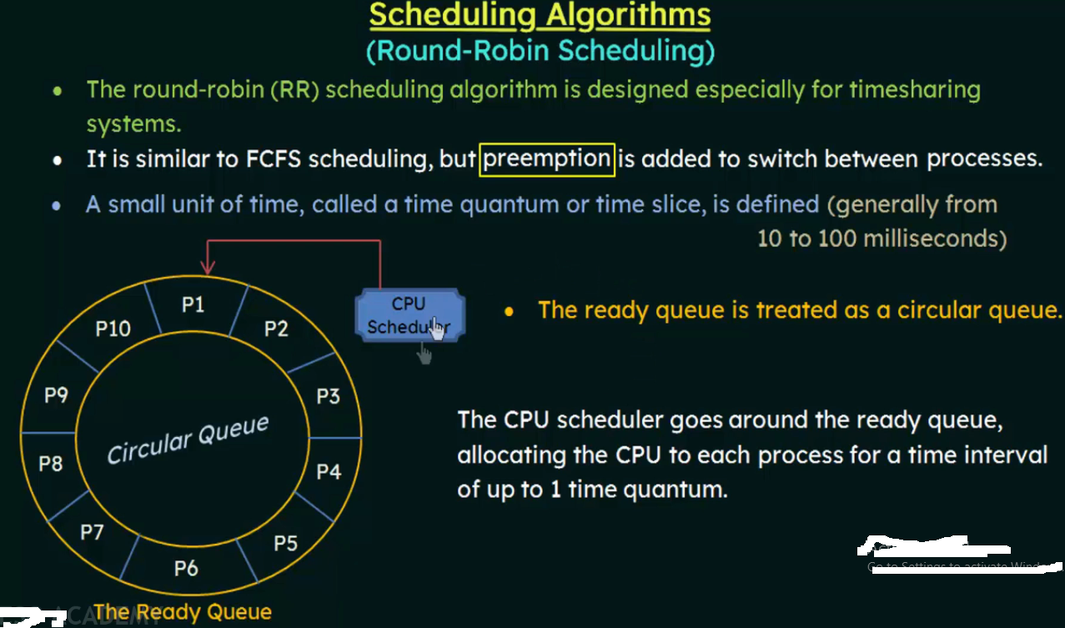

Slide 63
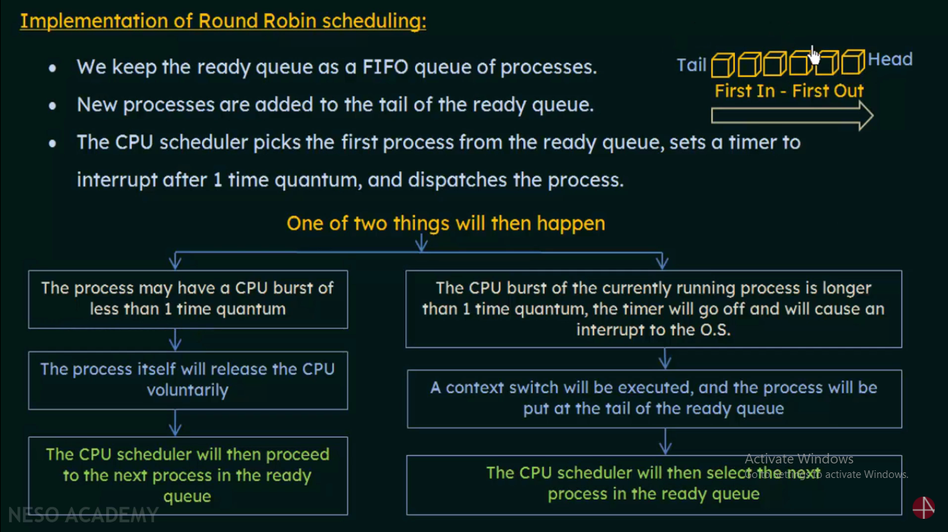

Slide 64
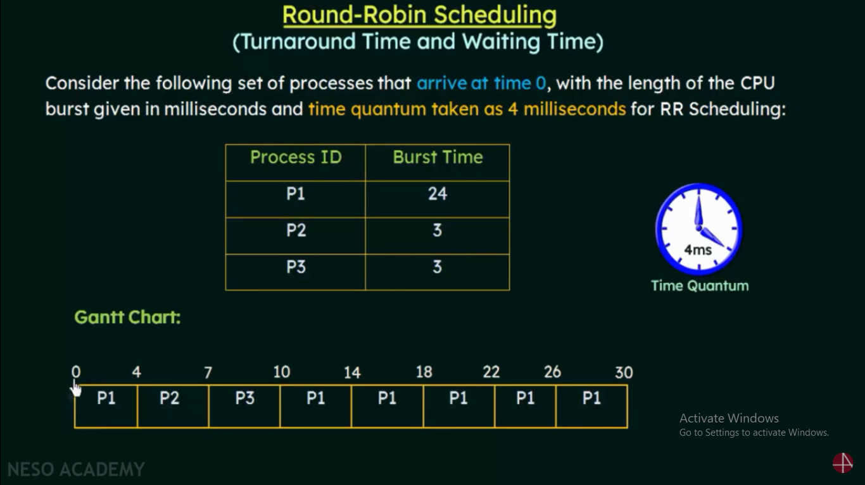

Slide 65
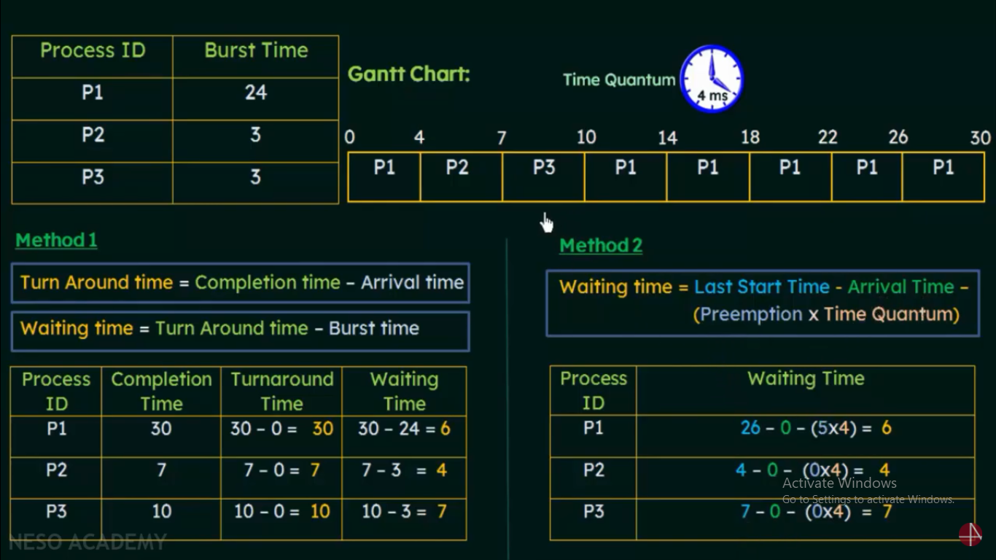

Slide 66
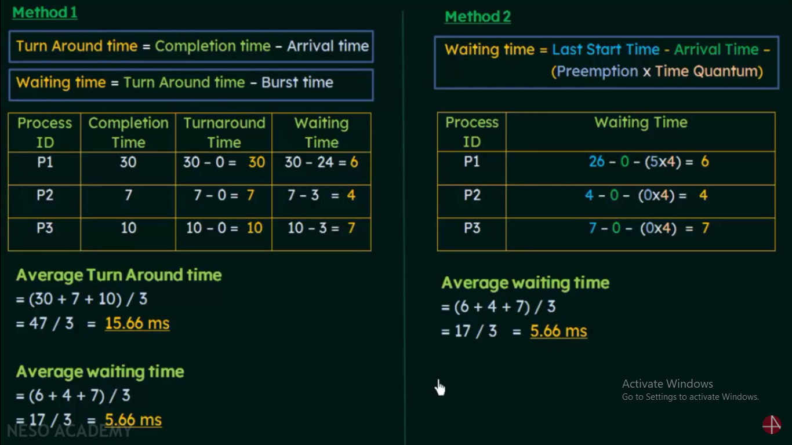

Slide 67
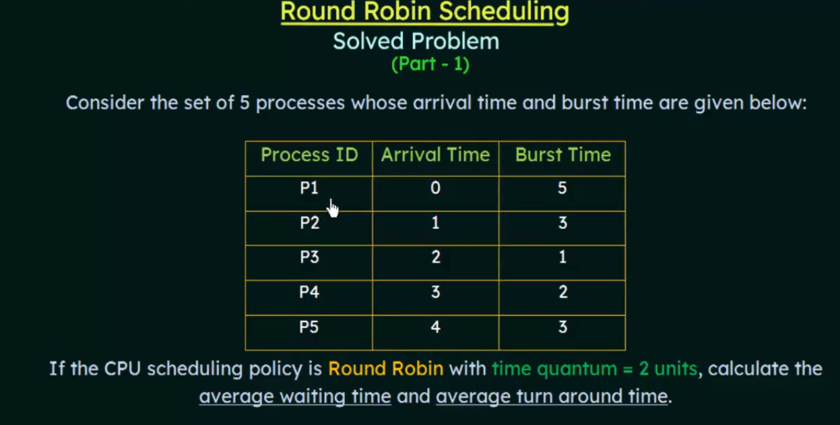

Slide 68
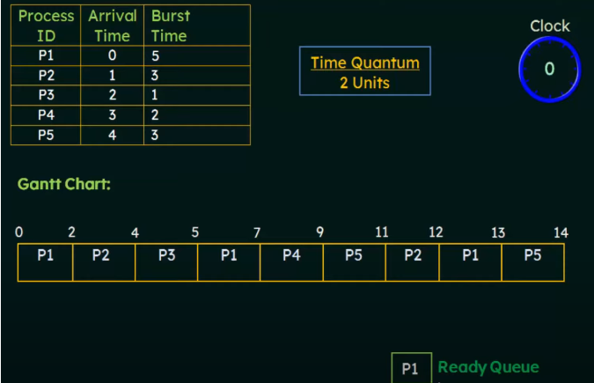

Slide 69
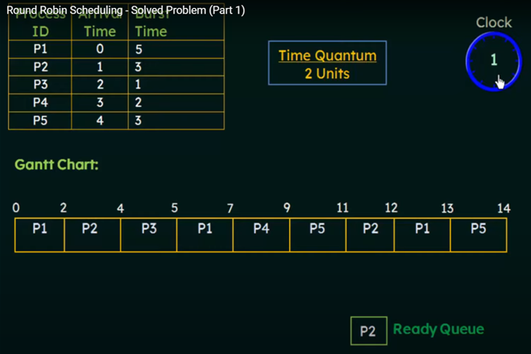

Slide 70
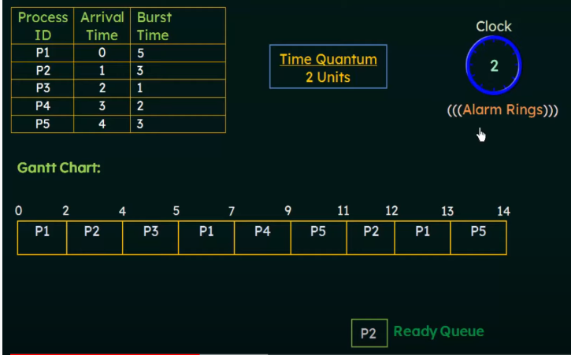

Slide 71
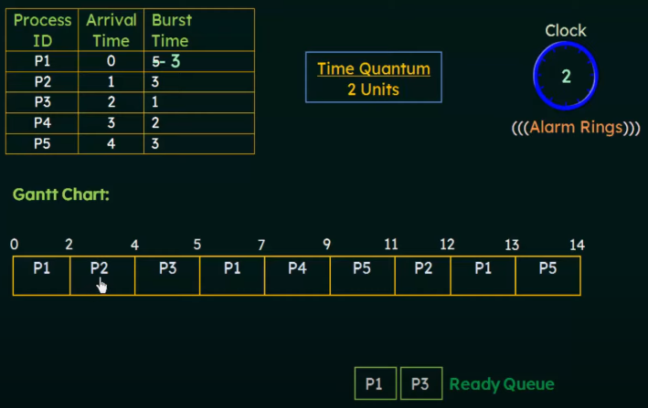

Slide 72
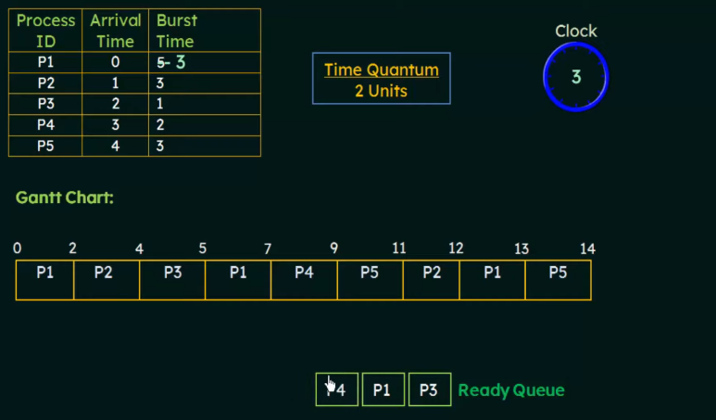

Slide 73
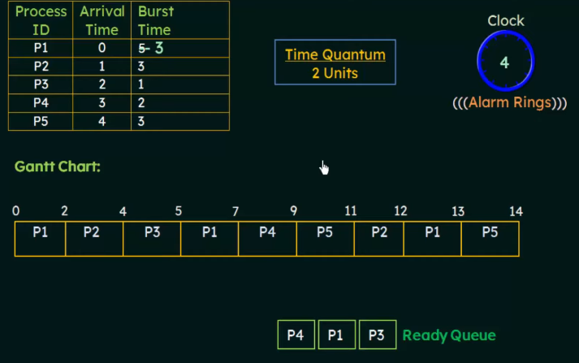

Slide 74
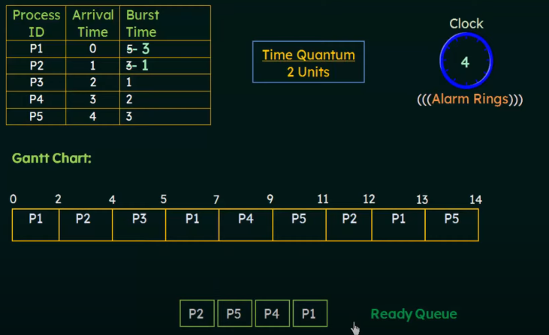

Slide 75
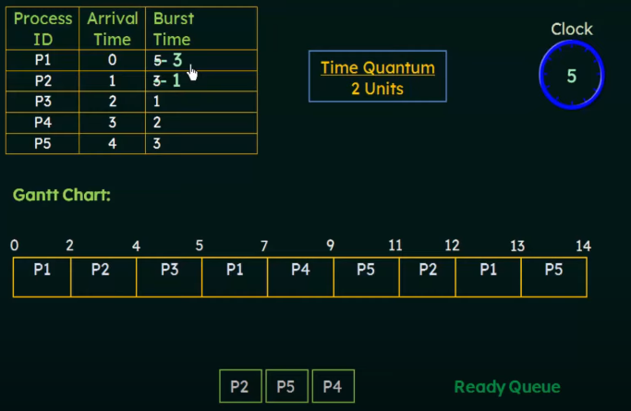

Slide 76
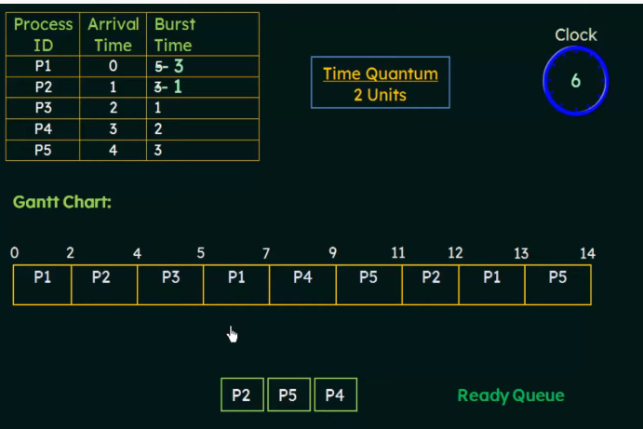

Slide 77
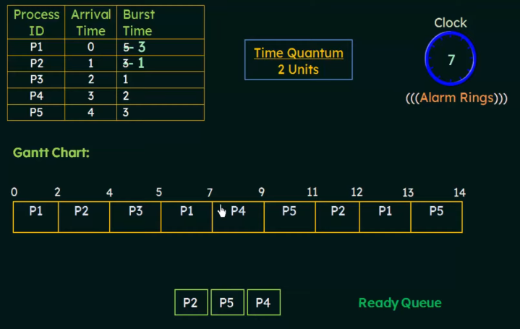

Slide 78
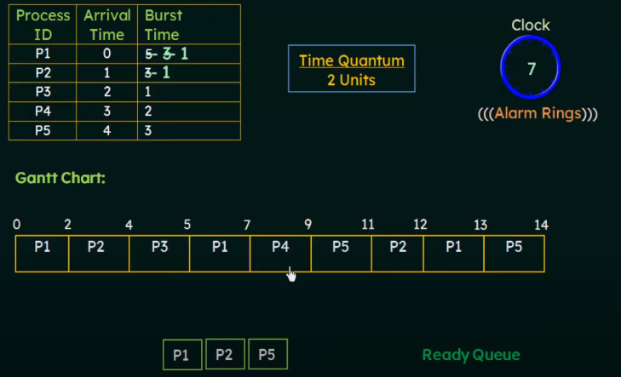

Slide 79
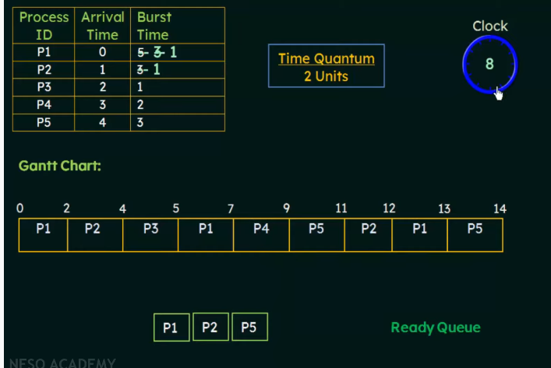

Slide 80
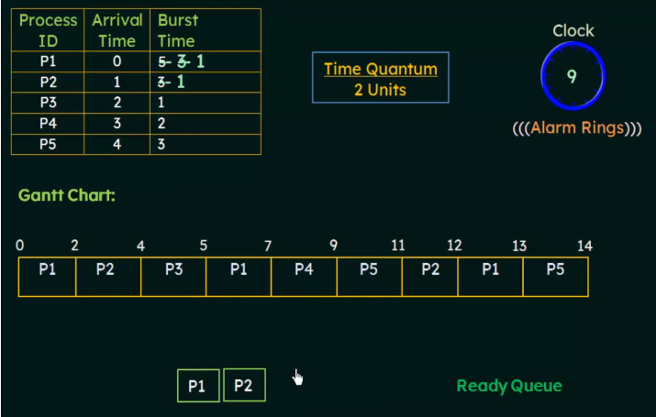

Slide 81
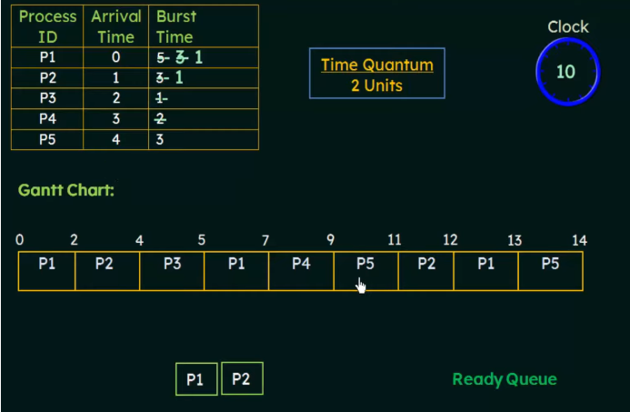

Slide 82
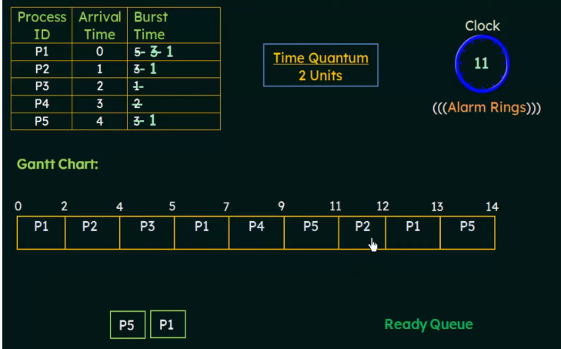

Slide 83
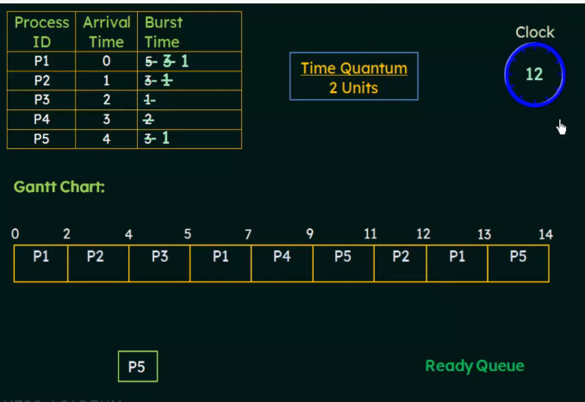

Slide 84
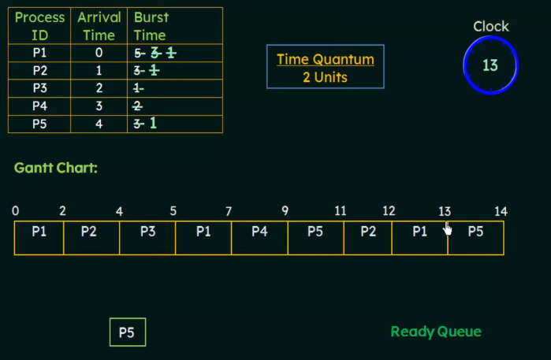

Slide 85
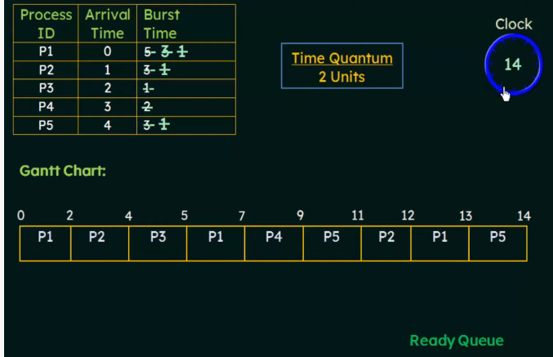

Slide 86


Slide 87


Slide 88


Slide 89

Circular Queue Datastructure
What is Circular Queue?
A circular queue is a linear data structure in which the operations are performed based on FIFO (First In First Out) principle and the last position is connected back to the first position to make a circle. A circular queue also called as a Ring Buffer can be implemented using arrays and linked lists.
Graphical representation of a circular queue is as follows...

Slide 90


This situation also says that Queue is Full and we cannot insert the new element because 'rear' is still at last position. In the above situation, even though we have empty positions in the queue we can not make use of them to insert the new element. This is the major problem in a normal queue data structure. To overcome this problem we use a circular queue data structure.

Slide 91
Advantage:
Circular queue can reutilized the empty places in the queue (where dequeue is performed) unlike linear queue.
It takes up less memory than the linear queue.
Doesn’t use dynamic memory → No memory leaks
Simple Implementation → easy to trust and test
Never has to reorganize / copy data around
All operations occur in constant time O(1)
Disadvantage:
Difficult to understand the full and empty condition for circular queue.
One element needs to be sacrificed to understand the queue full/empty conditions.
Have to know the max size beforehand

Slide 92


Slide 93

Method-1

Slide 94


Slide 95


Slide 96


Slide 97


Slide 98


Slide 99


Slide 100


Slide 101


Slide 102


Slide 103


Slide 104


Slide 105


Slide 106


Slide 107


Slide 108


Slide 109


Slide 110


Slide 111


Slide 112


Slide 113


Slide 114


Slide 115


Slide 116


Slide 117


Slide 118


Slide 119


Slide 120


Slide 121


Slide 122


Slide 123


Slide 124


Slide 125


Slide 126


Slide 128
Implementation of Circular Queue using Linked List
Using Circular Queue is better than normal queue because there is no memory wastage. Linked list provide the facility of dynamic memory allocation so it is easy to create. When we implement circular Queue using linked list it is similar to circular linked list except there is two pointer front and rear in circular Queue where as circular linked list has only one pointer head.

Slide 129

Implementation of Circular Queue using Linked List

Slide 130


Slide 131


Slide 132
Algorithm for Implementing Circular Queue using linked list
enqueue(int d)
Create a new node of structure node type.
New_node->data = entered data.
New_node->Next = NULL.
IF(Front == NULL)
THEN
Front = Rear = New_node
Rear->Next = Front
END IF
Front = New_node.
End IF.
ELSE
Rear->Next = New_node
Rear = New_node
New_node->Next = Front
End ELSE

Slide 133
dequeue()
Create a temporary pointer temp of node structure type
IF(Front == NULL)
Print ‘Underflow Condition’
End IF
ELSE IF(Front == Rear)
Front = Rear = NULL
Free(temp)
End ELSE IF
ELSE
Front = Front->Next
Rear->Next = Front
Free(temp)

Slide 134
print()
STRUCT NODE* TEMP
IF((FRONT == NULL)&&(REAR == NULL))
RETURN
ELSE
TEMP = FRONT
WHILE(TEMP)
RETURN TEMP->DATA
TEMP = TEMP->NEXT

Slide 135
#include<stdio.h>
#include<stdlib.h>
struct node
{
int data; struct node* next;
};
struct node *f = NULL;
struct node *r = NULL;

Slide 136



Slide 137



Slide 138


Slide 139
int main()
{
int opt,n,i,data;
printf("Enter Your Choice:-");
do
{
printf("\n\n1 for Insert the Data in Queue\n2 for show the Data in Queue \n3 for Delete the data from the Queue\n0 for Exit");
scanf("%d",&opt);
switch(opt)
{

Slide 140


Slide 141

Double Ended Queue Datastructure
Double Ended Queue is also a Queue data structure in which the insertion and deletion operations are performed at both the ends (front and rear). That means, we can insert at both front and rear positions and can delete from both front and rear positions. Thus, it does not follow FIFO rule (First In First Out).

Slide 142

Double Ended Queue can be represented in TWO ways, those are as follows...
Input Restricted Double Ended Queue
Output Restricted Double Ended Queue
Input Restricted Double Ended Queue
In input restricted double-ended queue, the insertion operation is performed at only one end and deletion operation is performed at both the ends.

Slide 143

Output Restricted Double Ended Queue
In output restricted double ended queue, the deletion operation is performed at only one end and insertion operation is performed at both the ends.

Slide 144
Operations on Deque: Mainly the following four basic operations are performed on queue: insertFront(): Adds an item at the front of Deque. insertRear(): Adds an item at the rear of Deque. deleteFront(): Deletes an item from front of Deque. deleteRear(): Deletes an item from rear of Deque. In addition to above operations, following operations are also supported getFront(): Gets the front item from queue. getRear(): Gets the last item from queue. isEmpty(): Checks whether Deque is empty or not. isFull(): Checks whether Deque is full or not.

Slide 145
Applications of Deque: Since Deque supports both stack and queue operations, it can be used as both.
The Deque data structure supports clockwise and anticlockwise rotations in O(1) time which can be useful in certain applications.
the problems where elements need to be removed and or added both ends can be efficiently solved using Deque

Slide 146

insertfront() insertrear() deletefront() deleterear()

Slide 147

Insert rear()

Slide 148

Insertrear()

Slide 149

DELETEFRONT

Slide 150


INSERTFRONT front– we cannot do front ++ again I want insert front now front = -1 queue is full in this case N-1 –front corner cases take care

Slide 151


deletefront not do front--, will do f++ if front =N-1 front=0 set

Slide 152

deleterear() rear--

Slide 153


Delete rear

Slide 154

deleterear()

Slide 155
Void main()
{
enqueuefront(2)
enqueuefront(5)
enqueuefront(-1)
enqueuerear(0)
enqueuefront(7)
enqueuefront(4)
display()
)

Slide 156

#define N 5
Int deque[N];
Int F=-1,R=-1;
Void enqueuefront(int x)
{
If((F==0 && R==N-1)||(front==rear+1))
{
printf(“queueis full”)
}
else if(f==-1&& R==-1)
{
F=R=0;
deque[F]=x;
}
elseif(f==0)
{
F=N-1;
deque[F]=x
}
else{
F—
deque[F]=x
}
}

Slide 157
Void enqueuerear(int x)
{
If((F==0 && R==N-1)||(front==rear+1))
{
printf(“queueis full”)
}
else if(f==-1&& R==-1)
{
F=R=0;
deque[R]=x;
}
elseif(R==N-1)
{
R=0;
deque[R]=x
}
else{
R++
deque[R]=x
}
}

Slide 158
Void display()
{
Int i=F
While(i !=rear)
{
Printf(“%d”.deque[i]);
i=(i+1)%N;
}
Printf(“%d”,deque[rear]);
}

Slide 159
Void getfront()
{
printf(“%d”,deque(front));
}
Void getrear()
{
Printf(%d”deque(rear));
}

Slide 160
Void dequeuefront()
{ if(F==-1 && R==-1)
{
Printf(“queue is empty”);
else if(F==R)
{
F=R=-1;
}
elseif(F==N-1)
{
printf(“dequeue element is%d”,deque[F]);
F=0;
}
Else{
Printf(“%d”,deque[F]);
F++;
}
}

Slide 161
Void dequeuerear()
{
if(F==-1 && R==-1)
{
printf(“queue is empty”);
else if(F==R)
{
F=R=-1;
}
elseif(R==0)
{
printf(“dequeue element is%d”,deque[R]);
R=N-1;
}
else{
printf(“%d”,deque[R]);
R--;
}
}

Slide 162
Priority Queue
A priority queue is a special type of queue in which each element is associated with a priority and is served according to its priority. If elements with the same priority occur, they are served according to their order in the queue.
Generally, the value of the element itself is considered for assigning the priority.
lowest value of key is at front and item with the highest value of key is at rear
For example, The element with the highest value is considered as the highest priority element. However, in other cases, we can assume the element with the lowest value as the highest priority element. In other cases, we can set priorities according to our needs.

Slide 163


Slide 164


Slide 165
Priority Queue
Priority Queue implementation using array is the one of the basic method to implement Queue.
In Priority Queue data who has highest priority remove from the Queue first and second highest priority element after it and so on.
In priority Queue each element has its own priority.
If priority is same for two elements then data remove on the basis of first come first serve.

Slide 166
Types of Priority Queue:
Min Priority Queue: In min priority Queue minimum number of value gets the highest priority and lowest number of element gets the highest priority.
Max Priority Queue: Max priority Queue is the opposite of min priority Queue in it maximum number value gets the highest priority and minimum number of value gets the minimum priority.

Slide 167
Priority Queue Implementation
Priority Queue can be impleted in two ways:
Using ordered Array: In ordered array insertion or enqueue operation takes O(n) time complexity because it enters elements in sorted order in queue. And deletion takes O(1) time complexity.
Using unordered Array:In unordered array deletion takes O(n) time complexity because it search for the element in Queue for the deletion and enqueue takes o(1) time complexity.

Slide 168
Steps for Implementing Priority Queue in C
Insertion
Ask the data and its priority from the user.
If front is equal to 0 and rear is equal to n-1 then Queue is full.
Else if front is equal to the -1 them queue is empty so we have initialize front and rear with 0.
Insert the data entered by user in Queue using rear.
If rear is equal to n-1 and front is not equal to 0 then there is empty space in queue before the front for using that space we will shift the elements of the queue with the help of front and rear.
Insert the data in the queue before at the position where given priority is greater then priority of the element in queue.

Slide 169
Deletion
Remove the element and the priority from the front of the queue.
Increase front with 1.
Print
Using loop take the starting point from the front of the queue and ending point from the rear of the queue and print the data.

Slide 170


Slide 171


Slide 172
Algorithm to implement Priority Queue using Array
Enqueue()
IF((Front == 0)&&(Rear == N-1))
PRINT “Overflow Condition”
Else
IF(Front == -1)
Front = Rear =0
Queue[Rear] = Data
Priority[Rear] = Priority
ELSE IF(Rear ==N-1)
FOR i=Front;i<=Rear;i++)
FOR(i=Front;i<=Rear;i++)
Q[i-Front] =Q[i]
Pr[i-Front] = Pr[i]
Rear = Rear-Front
Front = 0
FOR(i = r;i>f;i–)
IF(p>Pr[i])
Q[i+1] = Q[i] Pr[i+1] = Pr[i]
ELSE
Q[i+1] = data Pr[i+1] = p
Rear++

Slide 173
Dequeue()
IF(Front == -1)
PRINT “Queue Under flow condition”
ELSE
PRINT”Q[f],Pr[f]”
IF(Front==Rear)
Front = Rear = -1
ELSE
FRONT++

Slide 174
Print()
FOR(i=Front;i<=Rear;i++)
PRINT(Q[i],Pr[i])

Slide 175
Implementation of Priority Queue using Linked List
Implementation of priority Queue data structure by using linked list is efficient as compare to using arrays.
Linked list provide you the facility of Dynamic memory allocation.If we use Linked List for implementing Priority Queue then memory is not going to waste. We can free the memory which is not in use anymore.
This is the main advantage of using linked list over array to implement Queue.

Slide 176
Steps for Implementing Priority Queue using Linked List in C
enqueue(data)
In Enqueue function we will create a node and assign the data and priority in it.
Then we will check if front is null then we assign the new node address to front.
If front is pointing to some node then we traverse the linked list using temporary pointer till new node priority is highest to the priority of the data in linked list and there is not null.
Address of new node initialize to the temporary node and address of temporary next node assign to the new node link.

Slide 177
dequeue()
Check if queue is empty or not.
If queue is empty then dequeue is not possible.
Else store front in temp.
Print data of temp.
Free temp memory.
And make next of front as front.

Slide 178
print()
Check if there is some data in the queue or not.
If the queue is empty print “No data in the queue.”
Else define a node pointer and initialize it with front.
Print data of node pointer until the next of node pointer becomes NULL.

Slide 179


Slide 180
Algorithm for Implementing Priority Queue using linked list in C
enqueue(int d)
Create a new node of structure node type.
new_node->data = entered data.
new_node->Priority = priority.
IF(Front == NULL)||(Entered priorityPriority).
new_node->next = Front.
Front = new_node.
End IF.
ELSE
Temp = Front
WHILE((Temp->next!=NULL)&&(Temp->Priority<=Entered Priority)
Temp = Temp->next
new_node->next = temp->next
temp->next = new_node
End ELSE

Slide 181
dequeue()
Create a temporary pointer temp of node structure type
IF(Front == NULL)
Print ‘Underflow Condition’
End IF
ELSE
Temp = Front
Front = Front->Next
Print(data and priority)
Free(temp)
End ELSE

Slide 182
print()
STRUCT NODE* TEMP
IF((FRONT == NULL)&&(REAR == NULL))
RETURN
ELSE
TEMP = FRONT
WHILE(TEMP)
RETURN TEMP->DATA
TEMP = TEMP->NEXT

Slide 185
https://prepinsta.com/c-program/priority-queue-using-arrays/#:~:text=Steps%20for%20Implementing%20Priority%20Queue%20in%20C&text=Ask%20the%20data%20and%20its,user%20in%20Queue%20using%20rear.
https://prepinsta.com/c-program/implementation-of-priority-queue-using-linked-list/
https://www.youtube.com/watch?v=UanMiicXMOg

